Slide 1
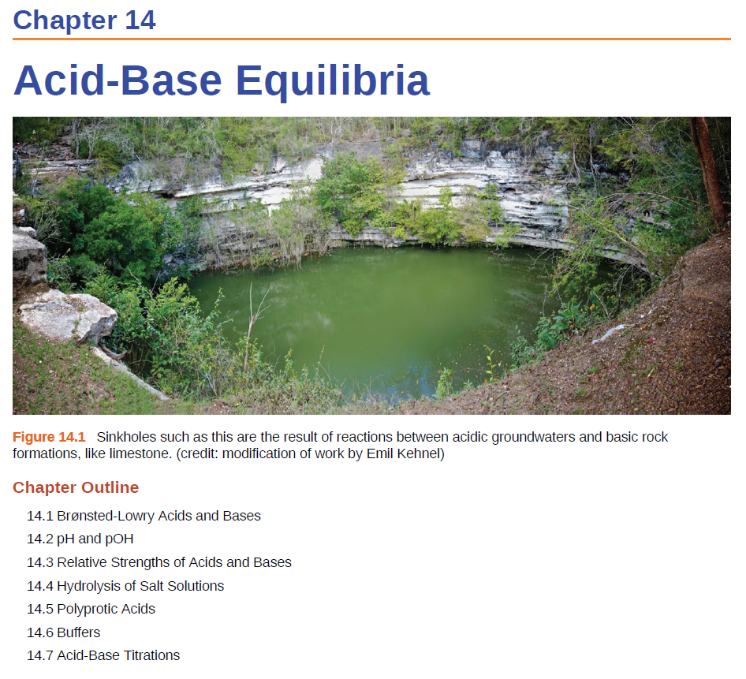

CH 4, Review

Slide 2
Acidic and Basic Salts
acid + base salt + water
HCl(aq) + NaOH(aq) NaCl(s) + H₂O
Salts are the ionic product of an acid base neutralization reaction. They are composed of related numbers of cations (positively charged ions) and anions (negative ions) so that the product is electrically neutral (without a net charge).
XY(s) X⁺(aq) + Y⁻(aq)
Soluble salts dissociate completely when dissolved in water.
Ions/salts may acidic, basic or neutral.

Slide 3
Neutral Salts
Dissociation and reaction of a neutral salt:
NaCl(aq) → Na⁺(aq) + Cl⁻(aq)
Na⁺(aq) + H₂O → NR
Cl⁻ (aq) + H₂O → NR
The concentrations of H⁺ and OH⁻ in NaCl solution are the same as in pure water ➔ solution is neutral.

Slide 4
Acidic Salts
Dissociation and reaction of a acidic salt:
NH₄NO₃ (aq) → NH₄⁺(aq) + NO₃⁻(aq)
NH₄⁺ (aq) + H₂O → NH₃(aq) + H₃O⁺(aq)
NO₃⁻(aq) + H₂O → NR
The reaction of NH₄⁺ with water causes [H⁺] > [OH-], and the solution becomes acidic.

Slide 5
Basic Salts
Dissociation and reaction of a basic salt:
NaNO₂(aq) → Na⁺(aq) + NO₂⁻(aq)
Na⁺(aq) + H₂O → NR
NO₂⁻(aq) + H₂O → HNO₂(aq) + OH⁻(aq)
The reaction of NO₂⁻ with water causes [OH⁻] > [H⁺] and the solution becomes basic.

Slide 6
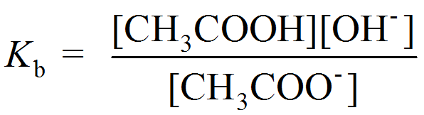
Calculate the pH of a 0.15 M solution of sodium acetate (CH₃COONa). (K_{b} of sodium acetate is 5.6 x 10⁻¹⁰)
0.15 M
0.15 M
H₂O
CH₃COONa (s) Na⁺ (aq) + CH₃COO⁻ (aq)
CH₃COO⁻(aq) + H₂O(l) CH₃COOH(aq) + OH⁻(aq)
0.15 M

Slide 7
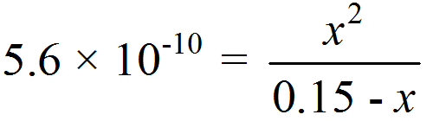
Calculate the pH of a 0.15 M solution of sodium acetate (CH₃COONa). (K_{b} of sodium acetate is 5.6 x 10⁻¹⁰)
[CH₃COO⁻] = 0.15 M
 | CH₃COO⁻ (aq) | + H₂O (l) |  | CH₃COOH(aq) | + OH⁻(aq)
Initial (M):
Change (M):
Equilibrium (M):
0.15
0.00
0.00
-x
+x
+x
0.15 - x
x
x
[CH₃COO⁻]₀
K_{b}
If > 400
we can neglect x

Slide 8
Calculate the pH of a 0.15 M solution of sodium acetate (CH₃COONa). (K_{b} of sodium acetate is 5.6 x 10⁻¹⁰)
[CH₃COO⁻] = 0.15 M
 | CH₃COO⁻ (aq) | + H₂O (l) |  | CH₃COOH(aq) | + OH⁻(aq)
Initial (M):
Change (M):
Equilibrium (M):
0.15
0.00
0.00
-x
+x
+x
0.15
9.2 x 10⁻⁶
9.2 x 10⁻⁶
x = 9.2 x 10⁻⁶
[OH⁻] = 9.2 x 10⁻⁶ M
pOH = -log (9.2 x 10⁻⁶ )
pOH = 5.04
pH = 14.00 - 5.04
pH = 8.96

Slide 9
Acidic and Basic Salts
Acidic Salts decrease the pH (generate more H⁺).
Neutral salts no change in pH ([H⁺] and [OH⁻] stay the same).
Basic salts increase the pH (generate more OH⁻).
NaCl
NaC₂H₃O₂
NH₄Cl
NaCl(aq) → Na⁺(aq) + Cl⁻(aq)
neutral salt
H₂O
CH₃COONa (s) Na⁺ (aq) + CH₃COO⁻ (aq)
basic salt
w.b.
NH₄NO₃ (aq) → NH₄⁺(aq) + NO₃⁻(aq)
acidic salt
w.a.

Slide 10
Acidic and Basic Salts
Basic Salt (with B)
NaB(s) → Na⁺(aq) + B⁻(aq)
[BH⁺][OH⁻]
B⁻(aq) + H₂O → BH⁺(aq) + OH-(aq)
K_{b} =
[B⁻]
Acidic Salt (with AH⁺)
AHCl(s) → AH⁺(aq) + Cl⁻(aq)
[H⁺][A]
AH⁺(aq) → A (aq) + H⁺(aq)
K_{a} =
[HA⁺]
What about AHB (with AH⁺ and B⁻)?
AHB(s) → AH⁺(aq) + B⁻(aq)
Generates H⁺
Generates OH⁻
Solutions in which both the cation and the anion hydrolyze:
K_{b} for the anion > K_{a} for the cation, solution will be basic
K_{b} for the anion < K_{a} for the cation, solution will be acidic
K_{b} for the anion ≈ K_{a} for the cation, solution will be neutral

Slide 11
Question:
Is (NH₄)₂SO₄ acidic, basic or neutral?
(NH₄)₂SO₄(aq) → 2NH₄⁺(aq) + SO₄²⁻(aq);
NH₄⁺(aq) + H₂O → H₃O⁺(aq) + NH₃(aq) K_{a} = 5.6 x 10⁻¹⁰
SO₄²⁻(aq) + H₂O → HSO₄⁻(aq) + OH⁻(aq) K_{b} = 8.3 x 10⁻¹³
A
B
C
K_{a} > K_{b} ➔ (NH₄)₂SO₄ is acidic.

Slide 12
Question:
Is NH₄C₂H₃O₂ acidic, basic or neutral?
NH₄C₂H₃O₂(s) → NH₄⁺(aq) + C₂H₃O₂⁻(aq)
NH₄⁺(aq) + H₂O → H₃O⁺(aq) + NH₃(aq) K_{a} = 5.6 x 10⁻¹⁰
C₂H₃O₂⁻(aq) + H₂O → HC₂H₃O₂(aq) + OH⁻(aq) K_{b} = 5.6 x 10⁻¹⁰
A
B
C
K_{a} = K_{b} ➔ NH₄C₂H₃O₂ is neutral
K_{a} > K_{b} ➔ (NH₄)₂SO₄ is acidic.

Slide 13
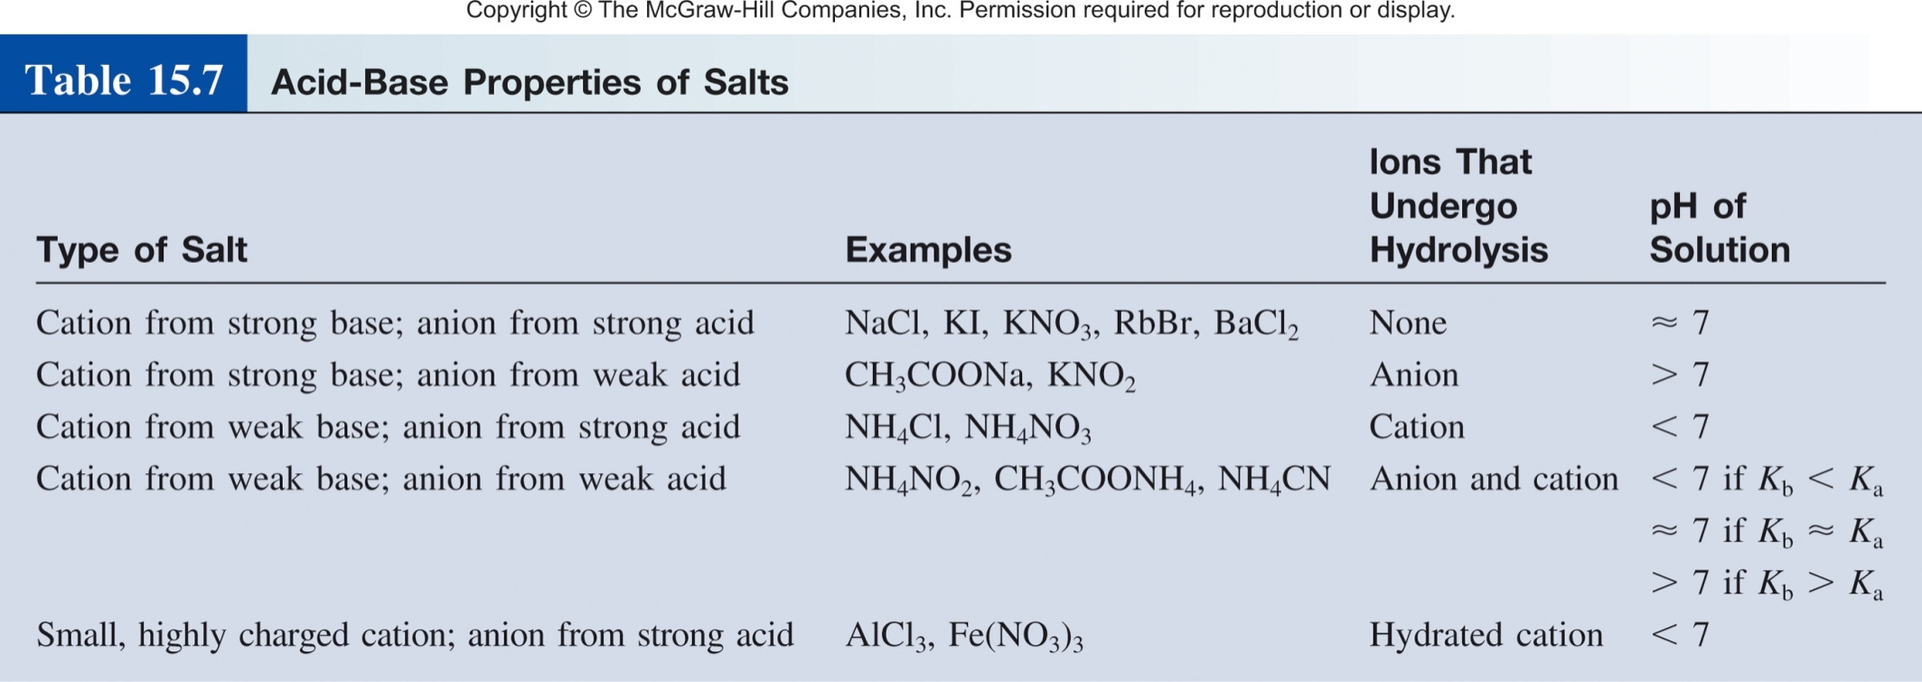
Acidic and Basic Salts Summary
XY(s) X⁺(aq) + Y⁻(aq)
K_{a}
K_{b}

Slide 14
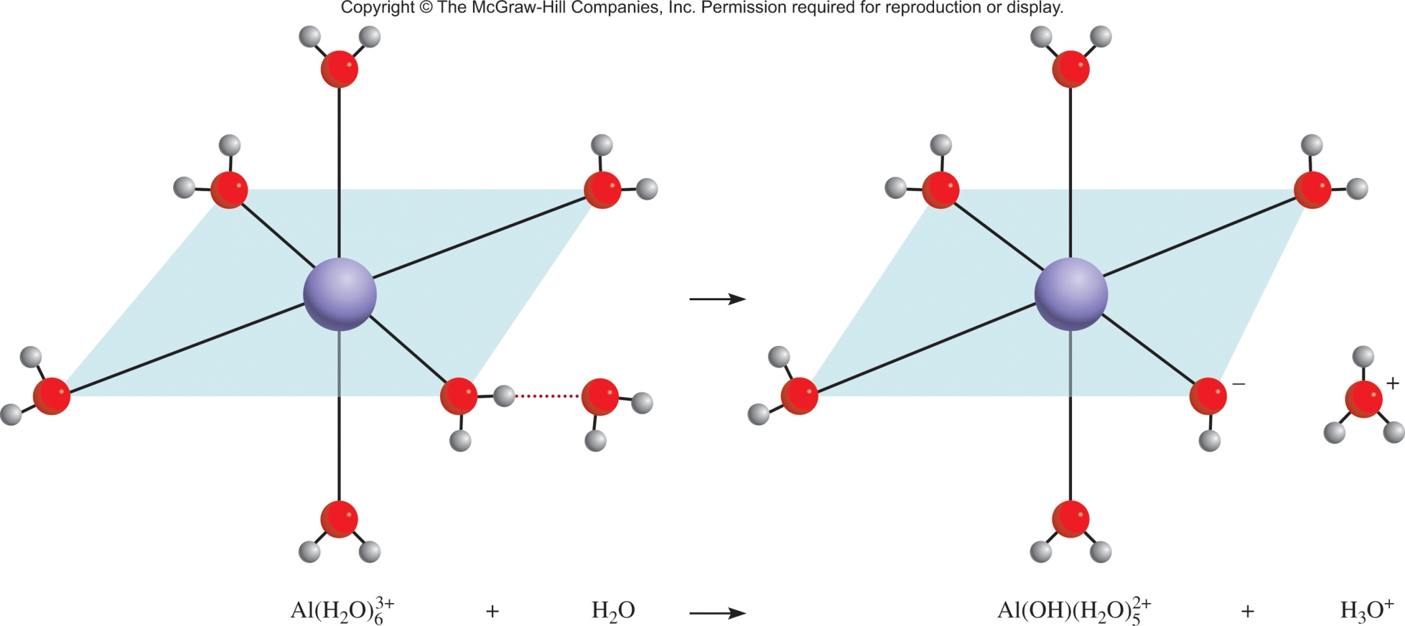

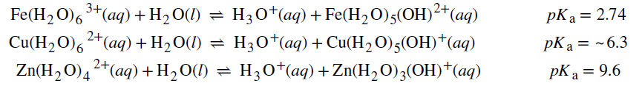
Side Note: Hydrated Metal Ions
Hydrated metal ions polarize coordinated water molecules and, consequently, act as Brønsted-Lowry acids:
Their solutions, therefore, are acidic.
This process is known as hydrolysis.
3+
2+
Al(H₂O)₆ (aq) Al(OH)(H₂O)₅ (aq) + H⁺ (aq)

Slide 15
Predict whether the following solutions will be acidic, basic, or nearly neutral:
NH₄I
(b) KNO₂
(c) FeCl₃
(d) NH₄F
NH₄I(s) → NH₄⁺(aq) + I⁻(aq)
Acidic Salt
acid
very weak base
Basic Salt
KNO₂(s) → K⁺(aq) + NO₂⁻(aq)
neutral
base
FeCl₃(s) → Fe⁺(aq) + 3Cl⁻(aq)
Acidic Salt
acid
very weak base
Acidic Salt
NH₄F(s) → NH₄⁺(aq) + F⁻(aq)
acid
base
K_{a} = 5.6 x 10⁻¹⁰
K_{b} = 1.4 x 10⁻¹¹

Slide 16
CH 4, Review

Slide 17
Monoprotic Bronsted Acid and Base
Bronsted Acids- able to donate protons in the form of hydrogen ions – protons – H⁺.
AH A⁻ + H⁺
HCl → Cl⁻ + H⁺
C₂H₃O₂H → C₂H₃O₂⁻ + H⁺
Bronsted Base- able to accept protons in the form of hydrogen ions or H⁺.
B⁻ + H⁺ BH
NH₃ + H⁺ → NH₄⁺
HO⁻ + H⁺ → H₂O

Slide 18
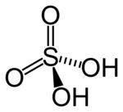
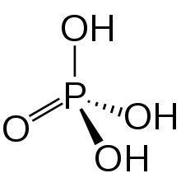
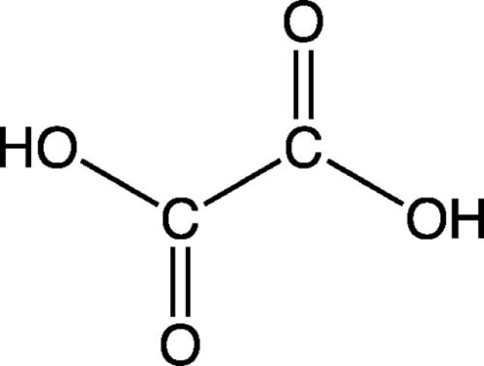
Polyprotic Bronsted Acid and Base
May yield more than one hydrogen ion per molecule.
Ionize in a stepwise manner; they lose one proton at a time.
H₂CO₃
HCO₃⁻ + H⁺
acid
conjugate base
acid
HCO₃⁻
CO₃²⁻ + H⁺
acid
conjugate base

Slide 19
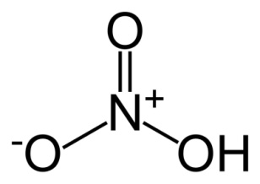
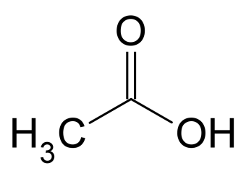
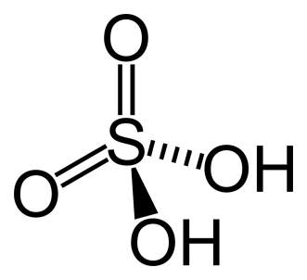
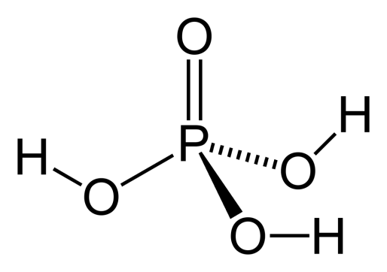
Mono- and Polyprotic Acids
Monoprotic acids
HCl H⁺ + Cl⁻
HNO₃ H⁺ + NO₃⁻
CH₃COOH H⁺ + CH₃COO⁻
Diprotic acids
H₂SO₄ H⁺ + HSO₄⁻
HSO₄⁻ H⁺ + SO₄²⁻
Triprotic acids
H₃PO₄ H⁺ + H₂PO₄⁻
H₂PO₄⁻ H⁺ + HPO₄²⁻
HPO₄²⁻ H⁺ + PO₄³⁻

Slide 20
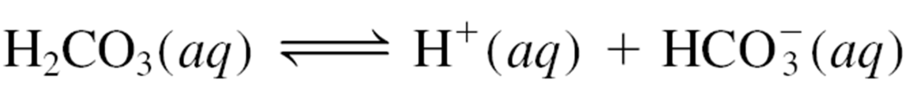
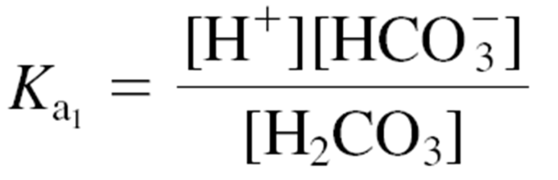
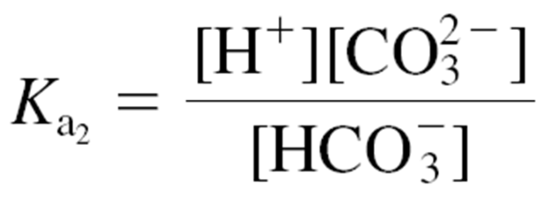
Polyprotic Bronsted Acid and Base
Ionize in a stepwise manner; they lose one proton at a time.
K_{a1}
K_{a2}
An ionization constant expression can be written for each
ionization stage.

Slide 21
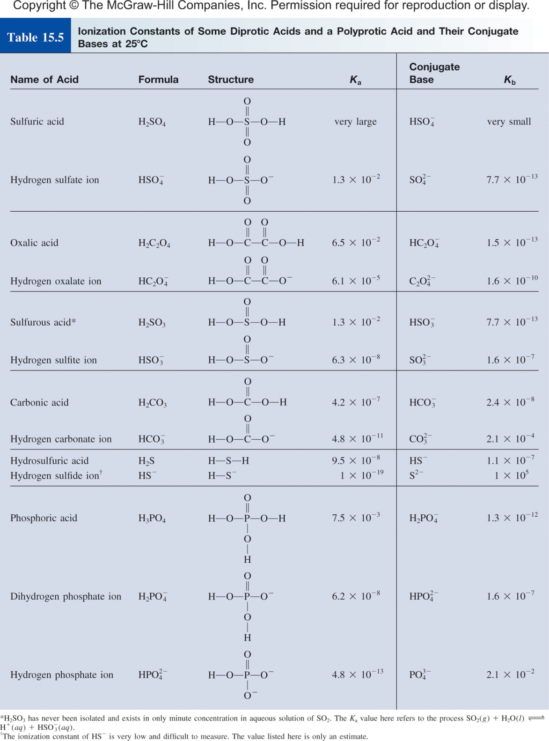
Polyprotic Bronsted Acid and Base
Conjugate base is the acid for the next equilibrium.
The second K_{a} is “always” smaller than the first.
The acid strength decreases as we go to the species with fewer protons.
Easier to separate H⁺ and X⁻ than H⁺ from X²⁻.
Consequently, two or more equilibrium constant expressions must often be used to calculate the concentrations of species in the acid solution.

Slide 22
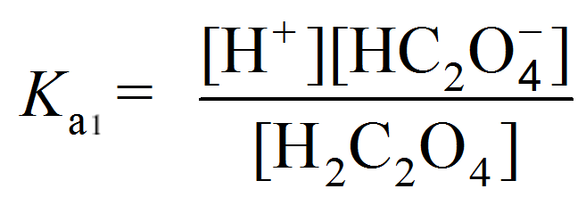
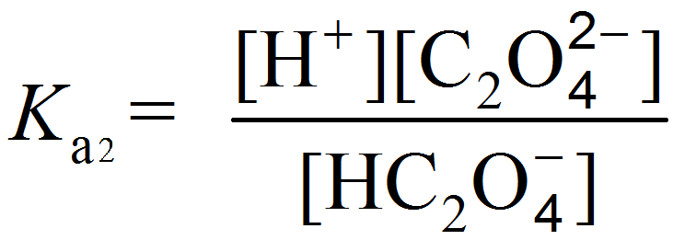
Oxalic acid (H₂C₂O₄) is a poisonous substance used chiefly as a bleaching and cleansing agent (for example, to remove bathtub rings). Calculate the concentrations of all the species present at equilibrium in a 0.10 M solution.
0.10 M
H₂C₂O₄(aq) |  | H⁺(aq) + | HC₂O₄⁻(aq)
K_{a1}
HC₂O₄⁻(aq) |  | H⁺(aq) + | C₂O₄²⁻(aq)
K_{a2}
From Table 15.5:
K_{a1} = 6.5 x 10⁻²
K_{a2} = 6.1 x 10⁻⁵

Slide 23
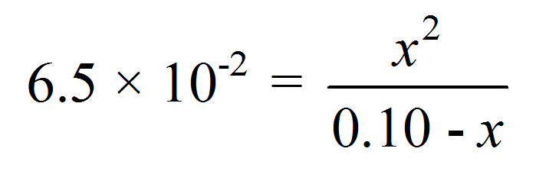
Oxalic acid (H₂C₂O₄) is a poisonous substance used chiefly as a bleaching and cleansing agent (for example, to remove bathtub rings). Calculate the concentrations of all the species present at equilibrium in a 0.10 M solution.
 | H₂C₂O₄(aq) |  | H⁺(aq) + | (aq)
Initial (M):
Change (M):
Equilibrium (M):
0.10
0.00
0.00
-x
+x
+x
0.10 - x
x
x
= 6.5 x 10⁻²

Slide 24
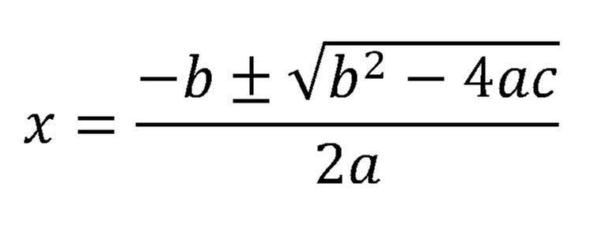
 | H₂C₂O₄(aq) |  | H⁺(aq) + | (aq)
Initial (M):
Change (M):
Equilibrium (M):
0.10
0.00
0.00
-x
+x
+x
0.10 - x
x
x
= 6.5 x 10⁻²
x² + 6.5 x 10⁻²x - 6.5 x 10⁻³ = 0
Can we neglect x?
[H₂C₂O₄]₀
K_{a1}
If > 400
we can neglect x
x = 0.054 M or -0.12 M

Slide 25
Oxalic acid (H₂C₂O₄) is a poisonous substance used chiefly as a bleaching and cleansing agent (for example, to remove bathtub rings). Calculate the concentrations of all the species present at equilibrium in a 0.10 M solution.
 | H₂C₂O₄(aq) |  | H⁺(aq) + | (aq)
Equilibrium (M):
0.10 - x
x
x
x = 0.054 M
[H⁺] = 0.054 M
[ ] = 0.054 M
[H₂C₂O₄] = 0.046 M
the major species are HC₂O₄⁻, which acts as the acid in the second stage of ionization to generate more H⁺, and C₂O₄²⁻.
HC₂O₄⁻(aq) |  | H⁺(aq) + | C₂O₄²⁻(aq)

Slide 26
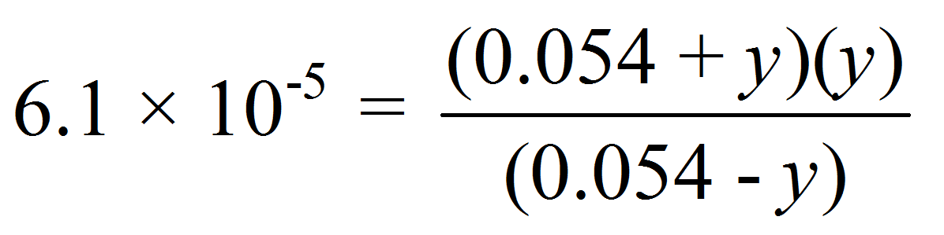
For equilibrium 2:
[H⁺] = 0.054 M
[ ] = 0.054 M
 | (aq) |  | H⁺(aq) + | (aq)
Initial (M):
Change (M):
Equilibrium (M):
0.054
0.054
0.00
-y
+y
+y
0.054 - y
0.054 + y
y
[HC₂O₄⁻]₀
K_{a2}
K_{a2} = 6.1 x 10⁻⁵
If > 400
y = 6.1 x 10⁻⁵ M
we can neglect y

Slide 27
Oxalic acid (H₂C₂O₄) is a poisonous substance used chiefly as a bleaching and cleansing agent (for example, to remove bathtub rings). Calculate the concentrations of all the species present at equilibrium in a 0.10 M solution.
K_{a1} = 6.5 x 10⁻²
0.10 M
H₂C₂O₄(aq) |  | H⁺(aq) + | HC₂O₄⁻(aq)
HC₂O₄⁻(aq) |  | H⁺(aq) + | C₂O₄²⁻(aq)
K_{a2} = 6.1 x 10⁻⁵
[H₂C₂O₄] = 0.046 M
[ ] = (0.054 - 6.1 x 10⁻⁵) M = 0.054 M
[H⁺] = (0.054 + 6.1 x 10⁻⁵) M = 0.054 M
[ ] = 6.1 x 10⁻⁵ M
[OH⁻] = 1.0 x 10⁻¹⁴/0.054 = 1.9 x 10⁻¹³ M

Slide 28
Example
Calculate the pH of a 0.10 M solution of H₃PO₄.
H₃PO₄(aq) ⇄ H⁺(aq) + H₂PO₄⁻(aq) K_{a1} = 7.5 x 10⁻³
H₂PO₄⁻(aq) ⇄ H⁺(aq) + HPO₄²⁻(aq) K_{a2} = 6.2 x 10⁻⁸
HPO₄²⁻(aq) ⇄ H⁺(aq) + PO₄³⁻(aq) K_{a3} = 4.8 x 10⁻¹³
Acid strength decreases in the order:
H₃PO₄ >> H₂PO₄⁻ >> HPO₄²⁻
pH of solution is determined mainly by ionization of H₃PO₄

Slide 29
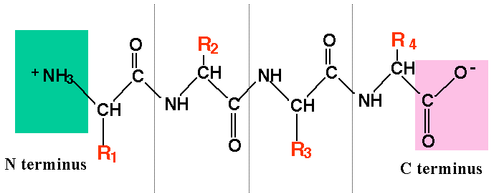
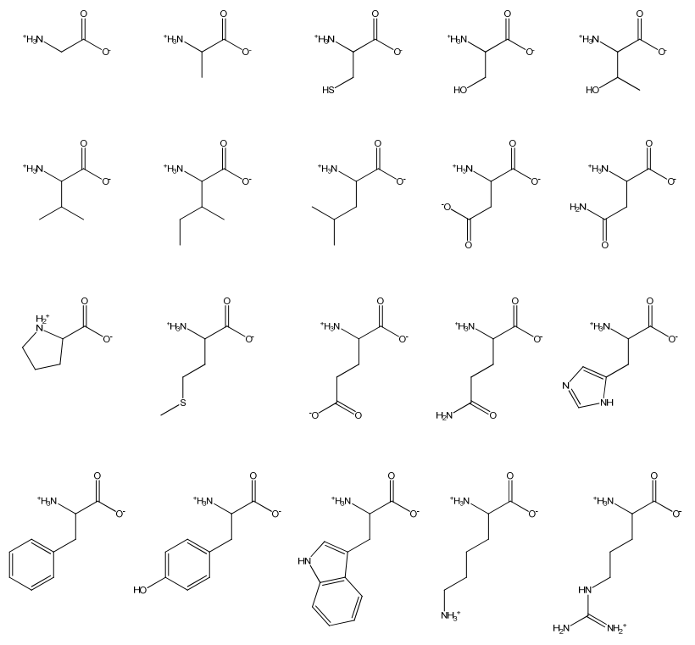
Polyprotic Peptides
Polypeptides
Proteins

Slide 30
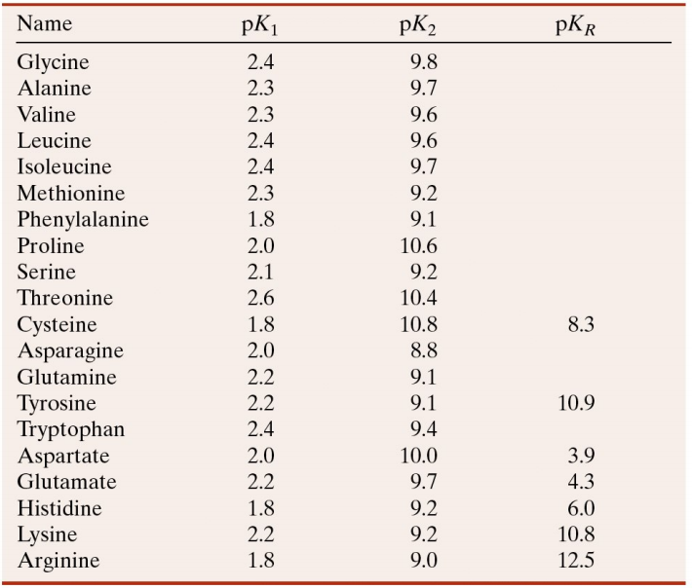
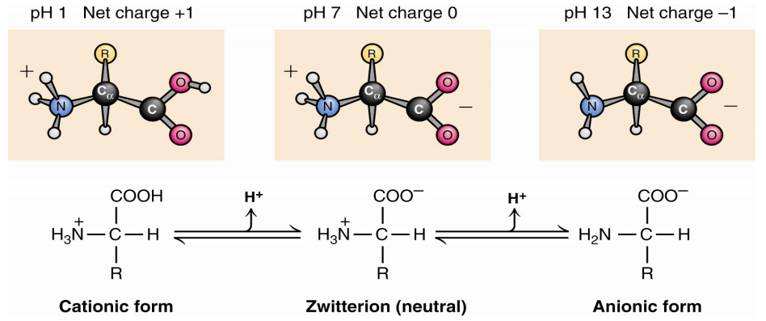
Polyprotic Peptides
pK_{a} = -log K_{a}
pK_{a3}
pK_{a2}
pK_{a1}

Slide 31
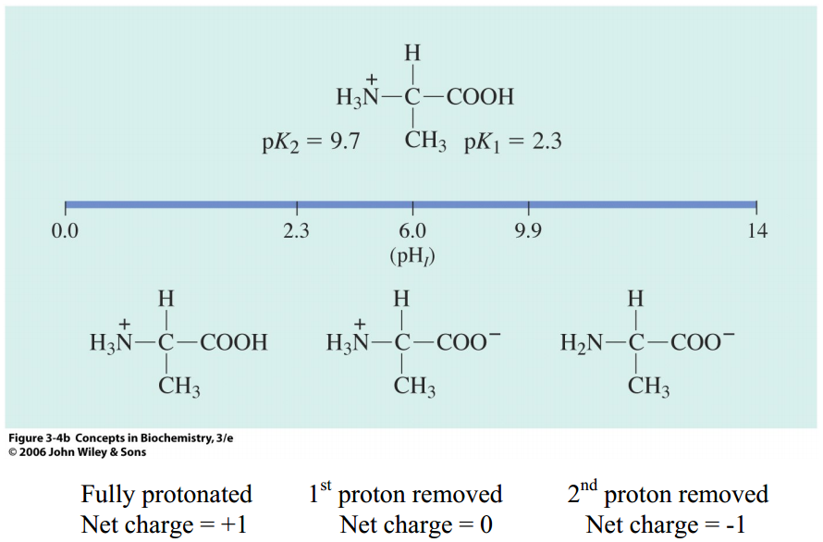
Polyprotic Peptides
Alanine

Slide 32
CH 4, Review

Slide 33
pH of a Solution
0.2 M
K_{a} = 1.8 x 10⁻⁵
CH₃COOH (aq) H⁺ (aq) + CH₃COO⁻ (aq)
 | AcOH(aq) |  | H⁺(aq) + | Ac⁻(aq)
Initial (M):
Change (M):
Equilibrium (M):
0.2
0.00
0.00
-x
+x
+x
0.2 - x
x
x
[H⁺] = 1.9 x 10⁻³ M
pH = -log (1.9 x 10⁻³ ) = 2.72
What happens to the pH if I add 0.30 M CH₃COONa?
Common Ion Effect!

Slide 34
Common Ion Effect
The common ion effect is the shift in equilibrium caused by the addition of a compound having an ion in common with the dissolved substance.
Specific case of LCP
CH₃COOH (aq) H⁺ (aq) + CH₃COO⁻ (aq)
Then we add some CH₃COONa (a strong electrolyte).
common ion
CH₃COONa (s) Na⁺ (aq) + CH₃COO⁻(aq)
The presence of a common ion suppresses the ionization of a weak acid or a weak base. It will influence the pH.
What is the pH if I add 0.30 M CH₃COONa?

Slide 35
Calculate the pH of a 0.20 M CH₃COOH solution.
(b) What is the pH of a solution containing both 0.20 M CH₃COOH and 0.30 M CH₃COONa? The K_{a} of CH₃COOH is 1.8 x 10⁻⁵.
(2.72)
0.20 M
?
 | CH₃COOH(aq) |  | H⁺(aq) + | CH₃COO⁻(aq)
CH₃COONa(aq) → Na⁺(aq) + CH₃COO⁻(aq)
0.30 M 0.30 M

Slide 36
(2.72)
Calculate the pH of a 0.20 M CH₃COOH solution.
(b) What is the pH of a solution containing both 0.20 M CH₃COOH and 0.30 M CH₃COONa? The K_{a} of CH₃COOH is 1.8 x 10⁻⁵.
 | CH₃COOH(aq) |  | H⁺(aq) + | CH₃COO⁻(aq)
Initial (M):
Change (M):
Equilibrium (M):
0.20
0
0.30
-x
+x
+x
0.20-x
x
0.30+x
[0.2]
K_{a}
If > 400
x = [H⁺] = 1.2 x 10⁻⁵ M
we can neglect x
-log (1.2 x 10⁻⁵ ) = 4.92

Slide 37
(2.72)
Calculate the pH of a 0.20 M CH₃COOH solution.
(b) What is the pH of a solution containing both 0.20 M CH₃COOH and 0.30 M CH₃COONa? The K_{a} of CH₃COOH is 1.8 x 10⁻⁵.
(4.92)
CH₃COOH (aq) H⁺ (aq) + CH₃COO⁻ (aq)
Then we add some CH₃COONa (a strong electrolyte).
common ion
CH₃COONa (s) Na⁺ (aq) + CH₃COO⁻(aq)
H⁺
pH
There is an easier way to calculate the pH for a common ion solution!

Slide 38
HH equation
Consider mixture of weak acid HA and salt NaA.
[H⁺][A⁻]
HA (aq) H⁺ (aq) + A⁻ (aq)
K_{a} =
[HA]
NaA (s) Na⁺ (aq) + A⁻ (aq)
K_{a} [HA]
[H⁺] =
[A⁻]
Henderson-Hasselbalch equation
[HA]
-log [H⁺] = -log K_{a} - log
[A⁻]
[conjugate base]
pH = pK_{a} + log
[A⁻]
[acid]
-log [H⁺] = -log K_{a} + log
[HA]
[A⁻]
pH = pK_{a} + log
pK_{a} = -log K_{a}
[HA]
Assumption: that the [A⁻] from NaA >> [A⁻] from HA (x is negligible)

Slide 39
(2.72)
Calculate the pH of a 0.20 M CH₃COOH solution.
(b) What is the pH of a solution containing both 0.20 M CH₃COOH and 0.30 M CH₃COONa? The K_{a} of CH₃COOH is 1.8 x 10⁻⁵.
(4.92)
CH₃COOH (aq) H⁺ (aq) + CH₃COO⁻ (aq)
Then we add some CH₃COONa (a strong electrolyte).
CH₃COONa (s) Na⁺ (aq) + CH₃COO⁻(aq)
[A⁻]
pH = pK_{a} + log
[HA]
[0.30]
pH = -log (1.8 x 10⁻⁵) + log
= 4.92
[0.20]

Slide 40
Buffer Solutions
A buffer solution consists of:
A weak acid (or weak base)
and
2. The salt of the weak conjugate base (or weak acid)
Both must be present!
HA (or B⁻)
A⁻ (or BH)
If there is a high concentration of A⁻ and HA, the buffer solution has the ability to resist changes in pH upon the addition of small amounts of either strong acids or bases.
The presence of a conjugate acid-base pair of a weak acid “ties up” small amounts of H⁺ or OH– ions added to the solution.

Slide 41
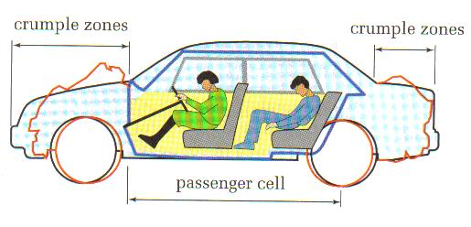
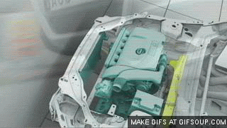
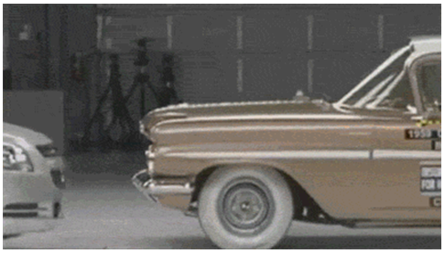
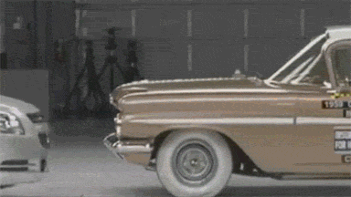
Crumple Zones
Sacrificial portion of the car that protects the passengers.
“They don’t make em’ like they use to!”
2000 Chevrolet Malibu vs. 1959 Chevrolet Bel Air (30 mph)
Buffer- the chemical equivalent to a crumple zone.

Slide 42
Buffer Solutions
Without Buffer
+ HCl
H⁺
[HCl] = [H⁺]
H⁺
+ NaOH
OH⁻
[NaOH] = [OH⁻]
OH⁻
With Buffer
A–(aq) + H⁺(aq) ⎯→ HA(aq)
[HCl] > [H⁺]
Some tied up as HA
+ HCl
HA
AH
HA
A⁻
AH
HA
HA
A⁻
HA
+ NaOH
A⁻
HA(aq) + OH–(aq) ⎯→
A–(aq) + H₂O(l)
A⁻
HA
A⁻
A⁻
HA
[NaOH] > [OH⁻]
Some tied up as H₂O
A⁻
A⁻
A⁻

Slide 43
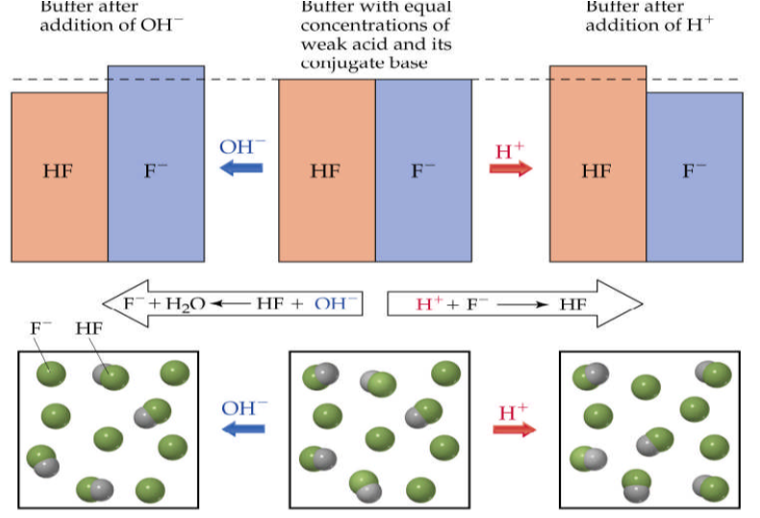
Buffer Solutions

Slide 44
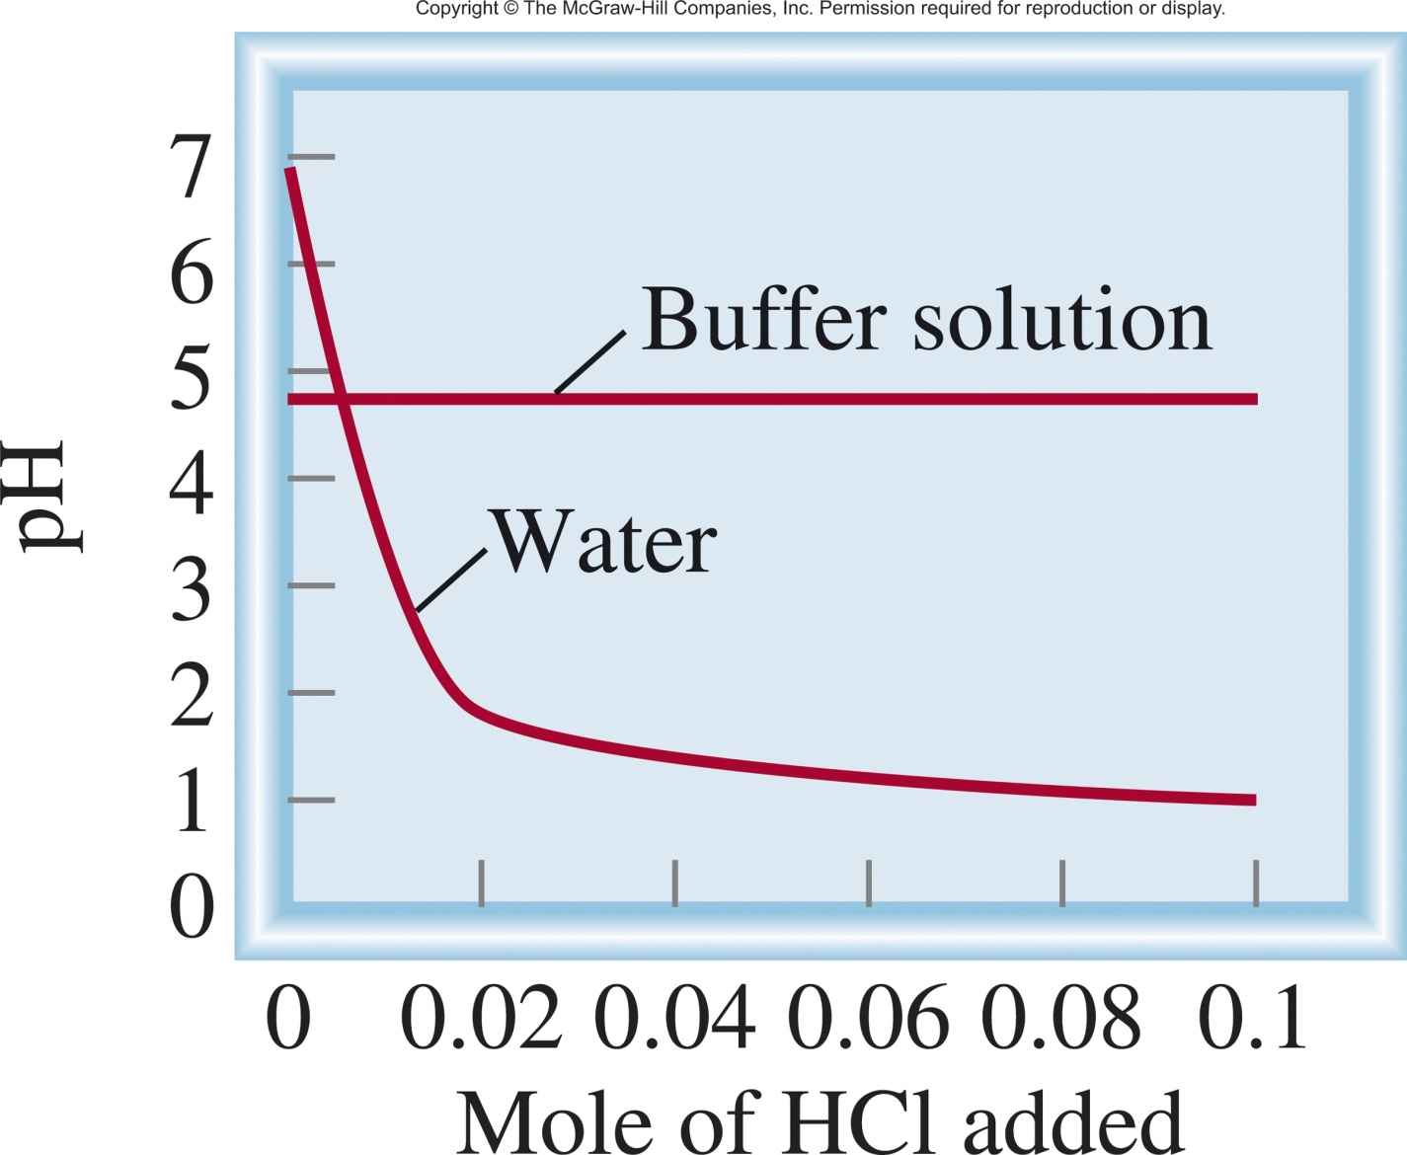
Buffer Solutions
Adding HCl:
Water
vs.
Buffer w/
1.0 M CH₃COOH
1.0 M CH₃COONa
In Water
If you add enough HCl, all of the CH₃COO⁻ will be consumed.
HCl ⎯→ H⁺ + Cl⁻ Wins!
HCl(aq) H⁺(aq) + Cl⁻(aq)
In Buffer
H⁺ (aq) + CH₃COO⁻ (aq) CH₃COOH (aq)

Slide 45
Question:
Which of the following solutions can be classified as buffer systems?
(a) KH₂PO₄/H₃PO₄
(b) NaClO₄/HClO₄
(c) NH₃/NH₄⁺
(d) H₂CO₃/K₂CO₃
A) Yes B) No C) I don’t know.
Conjugate acid-base?
Weak acid/weak base?

Slide 46
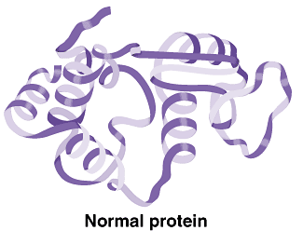

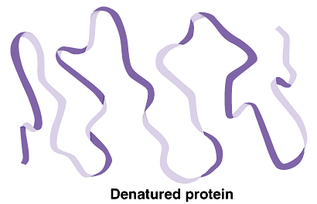




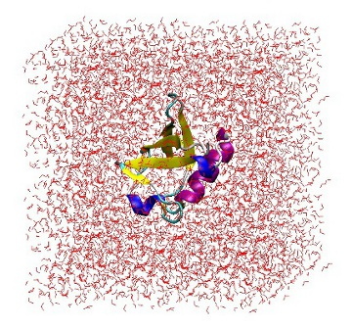
Crumple Zones
more
H⁺ or OH⁻
H⁺ or OH⁻
H⁺
OH⁻

Slide 47
Buffer Capacity
Buffer capacity is its ability to resist pH changes.
The more concentrated the components of a buffer, the greater the buffer capacity.
A buffer also has the highest capacity when the component concentrations are equal:
A buffer whose pH is equal to or near the pK_{a} of its acid component has the highest buffer capacity.
The addition of strong acid or base weakens the buffer capacity.

Slide 48
(a) Calculate the pH of a buffer system containing 1.0 M CH₃COOH and 1.0 M CH₃COONa. The K_{a} of CH₃COOH is 1.8 x 10⁻⁵ (Table 15.3).
(b) What is the pH of the buffer system after the addition of 0.10 mole of gaseous HCl to 1.0 L of the solution? Assume that the volume of the solution does not change when the HCl is added.

Slide 49
(a) Calculate the pH of a buffer system containing 1.0 M CH₃COOH and 1.0 M CH₃COONa. The K_{a} of CH₃COOH is 1.8 x 10⁻⁵ (Table 15.3).
[A⁻]
pH = pK_{a} + log
pK_{a} = -log K_{a}
[HA]
[1.0]
pH = -log (1.8 x 10⁻⁵) + log
= 4.74
[1.0]

Slide 50
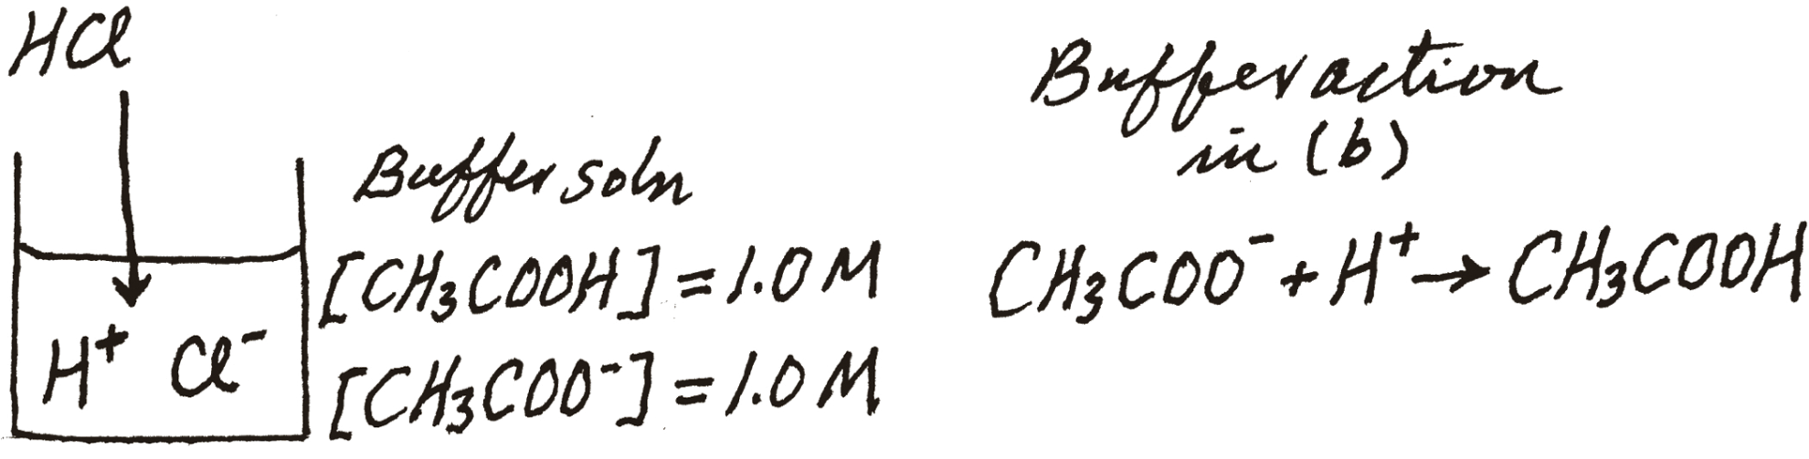
Calculate the pH of a buffer system containing 1.0 M CH₃COOH and 1.0 M CH₃COONa. The K_{a} of CH₃COOH is 1.8 x 10⁻⁵ (Table 15.3).
(b) What is the pH of the buffer system after the addition of 0.10 mole of gaseous HCl to 1.0 L of the solution?
(4.74)
0.10 M
0.10 M
 | CH₃COO⁻(aq) | + H⁺(aq) | → | CH₃COOH(aq)
Initial (mol):
Change (mol):
Final (mol):
1.0
0.10
1.0
-0.10
-0.10
+0.10
0.90
0
1.1
[0.9]
pH = -log (1.8 x 10⁻⁵) + log
= 4.66
[1.1]

Slide 51
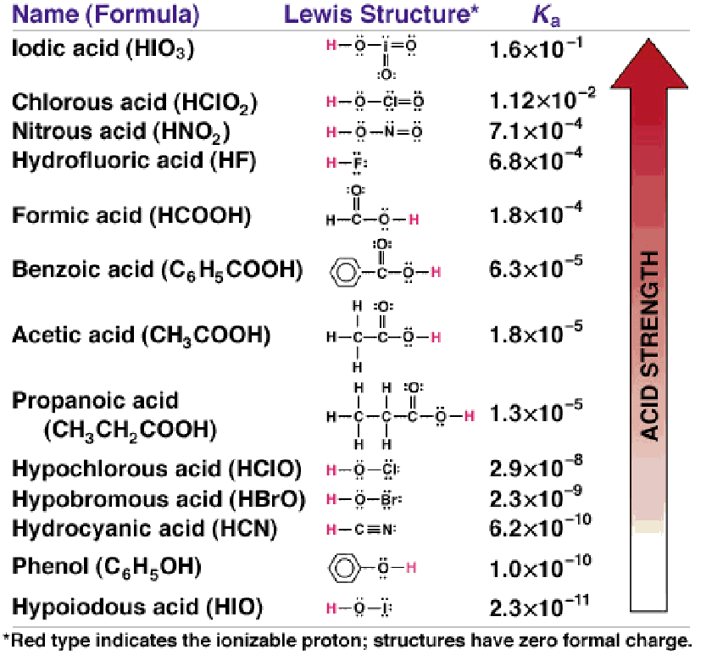
Preparing a Buffer Solution
Choose a target pH. Depends on what you want to study.
Choose the appropriate choice of a weak acid and conjugate base.
Most effective buffer when the pK_{a} is closest to the target pH.
Either:
Mix the Acid/salt in the appropriate ratio.
or
The acid and its salt are mixed in a 1 to 1 ratio.
The pH is then adjusted by adding a strong acid or base until it equals your target pH.

Slide 52
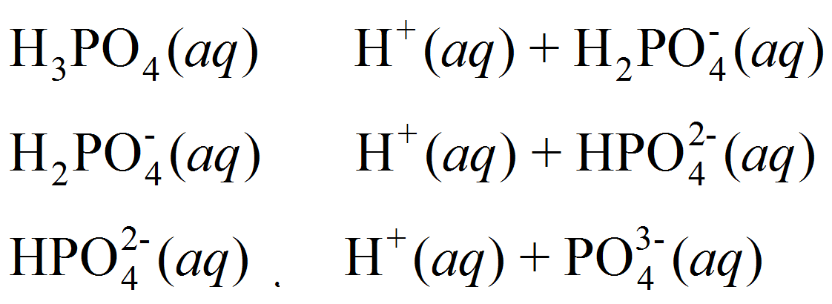
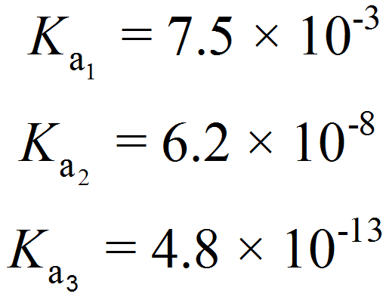
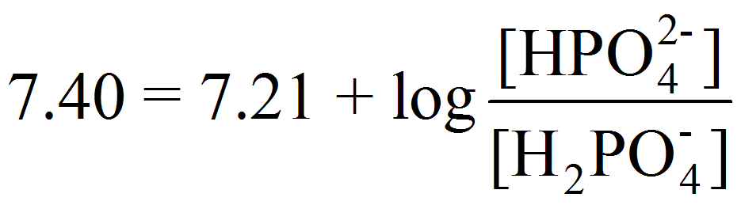
Describe how you would prepare a “phosphate buffer” with a pH of 7.40.
[A⁻]
pH = pK_{a} + log
[HA]
Known (7.40)
Find the ratio
Choose the right acid/salt
Most Effective when pH = pK_{a}
[A⁻]
7.4 = -log (6.2 x 10⁻⁸) + log
[HA]

Slide 53
Describe how you would prepare a “phosphate buffer” with a pH of 7.40.
[A⁻]
pH = pK_{a} + log
[HA]
Known (7.40)
Find the ratio
Choose the right acid/salt
Make the buffer:
Dissolve disodium hydrogen phosphate (Na₂HPO₄) and sodium dihydrogen phosphate (NaH₂PO₄) in a mole ratio of 1.5:1.0 in water.
or
Dissolve disodium hydrogen phosphate (Na₂HPO₄) and sodium dihydrogen phosphate (NaH₂PO₄) in a mole ratio of 1.0:1.0 in water. Then add 0.2 equivalence of a strong base.
[1+x]
7.40 = 7.21 + log
x = 0.2
[1-x]

Slide 54
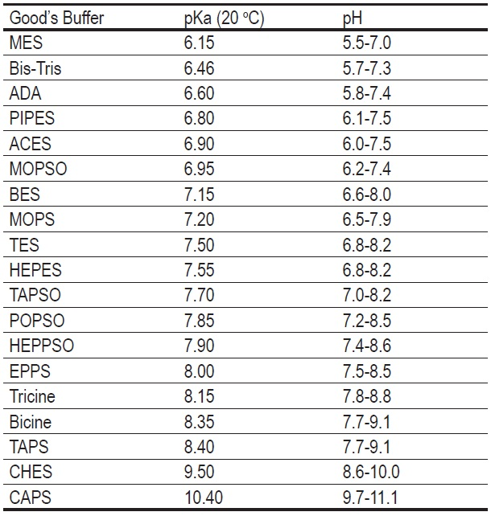
Biochem Relevant Buffers

Slide 55
Relevant Equations Summary
1) K_{w} = [H⁺][OH⁻] = 1.0 x 10⁻¹⁴
B⁻(aq) + H₂O(l) BH(aq) + OH⁻(aq)
2) pH = -log [H⁺]
[BH][OH⁻]
K_{b} =
3) pOH = -log [OH]
[B⁻]
4) pH + pOH = 14
HA_{(aq)} H⁺_{(aq)} + A⁻_{(aq)}
[H⁺][A⁻]
5) K_{a}K_{b} = K_{w}
K_{a} =
[HA]
Henderson-Hasselbalch equation
HA (aq) H⁺ (aq) + A⁻ (aq)
NaA (s) Na⁺ (aq) + A⁻ (aq)
[A⁻]
pH = pK_{a} + log
[HA]
Assumption: that the [A⁻] from NaA >> [A⁻] from HA

Slide 56
CH 4, Review

Slide 57
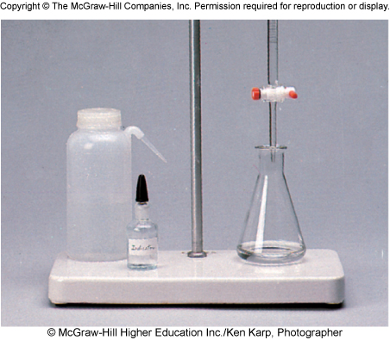
Titrations
In a titration, a solution of accurately known concentration is gradually added to another solution of unknown concentration until the chemical reaction between the two solutions is complete.
Redox titration
Complexometric indicator
Acid-base titration
Acid-Base Titration is a neutralization process aimed at adding a necessary amount of acid/H⁺ (or base/OH⁻) to a solution of base/OH⁻ (or acid/H⁺) in order to reach the equivalence point.
At the equivalence point, the number of moles of added H₃O⁺ (or OH–) ions equals the number of moles of OH– (or H₃O⁺) ions originally present.

Slide 58
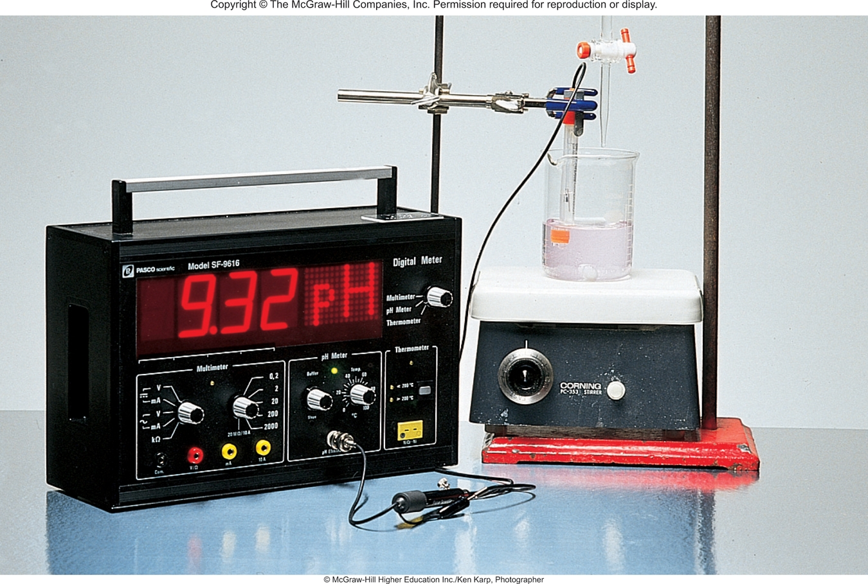
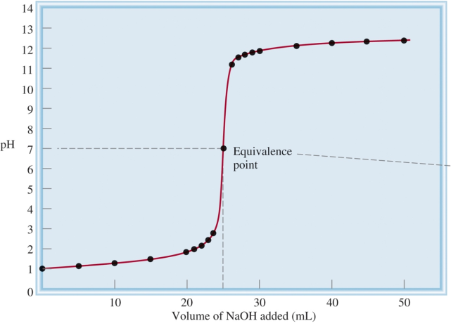
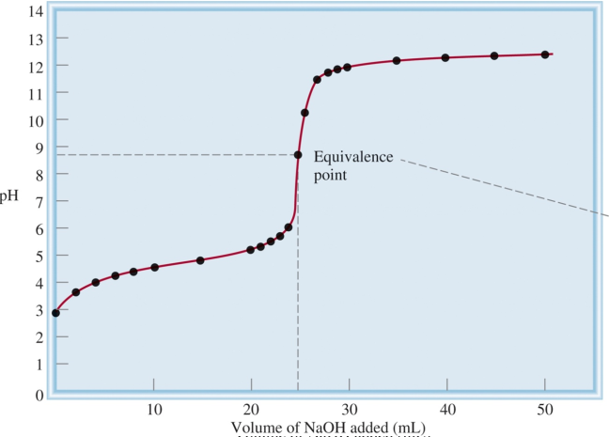
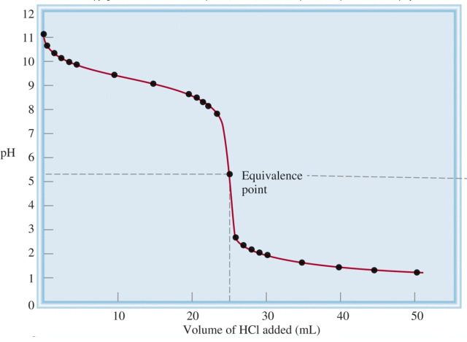
The Experiment
Start with [unknown] solution.
Add known amounts of an acid or base.
Monitor pH with respect to amount added.
Graph pH vs concentration.
Find equivalence point.
Find pK_{a} of weak acid or base.
Strong base to a strong acid.
Strong base to a weak acid.
Strong acid to a weak base.

Slide 59
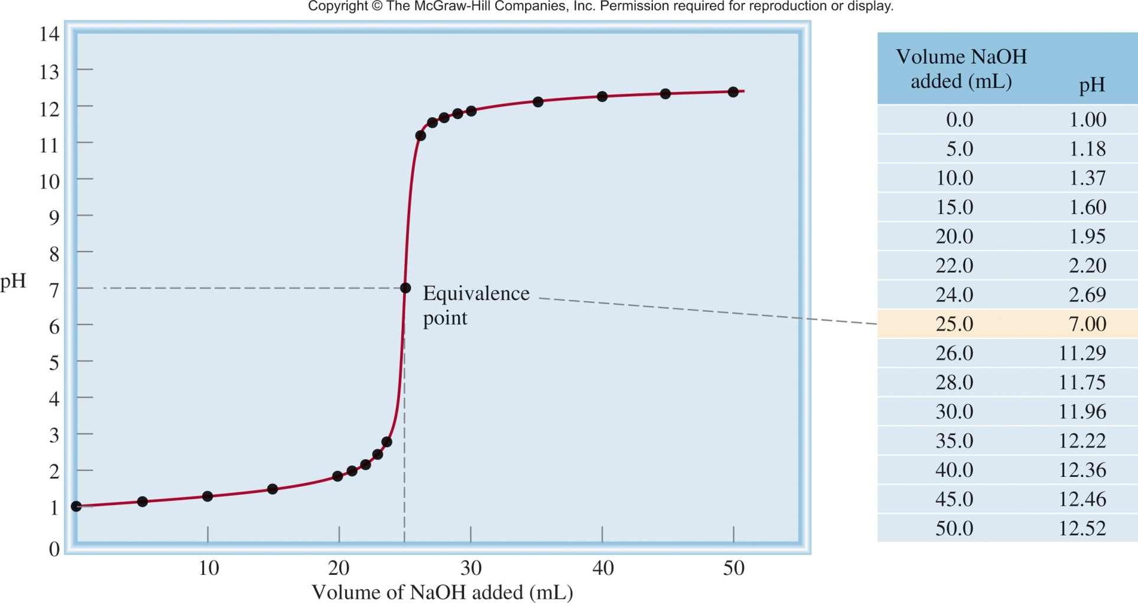
Strong base to strong acid
NaOH
HCl
NaOH (aq) + HCl (aq) H₂O (l) + NaCl (aq)
Strong means they completely dissociate.
Na⁺ + OH⁻ + H⁺ + Cl⁻ H₂O (l) + Na⁺ + Cl⁻
OH⁻ (aq) + H⁺ (aq) H₂O (l)
25.0 mL of 0.1 M HCl
adding 0.1 M NaOH

Slide 60
Strong base to strong acid
NaOH (aq) + HCl (aq) H₂O (l) + NaCl (aq)
Start with:
25.0 mL of 0.1 M HCl
Adding:
0.1 M NaOH
Since they completely react we can easily calculate the pH when:
1) After the addition of 0 mL of 0.1 M NaOH.
0.1 M HCl = 0.1 M H⁺
pH = -log [H⁺]
pH = 1

Slide 61



Strong base to strong acid
NaOH (aq) + HCl (aq) H₂O (l) + NaCl (aq)
Start with:
25.0 mL of 0.1 M HCl
Adding:
0.1 M NaOH
Since they completely react we can easily calculate the pH when:
1) After the addition of 10 mL of 0.1 M NaOH.
moles of NaOH/OH⁻
conc of HCl/H⁺ after the reaction
moles of HCl/H⁺
total volume (25 + 10 mL)

Slide 62
Strong base to strong acid
NaOH (aq) + HCl (aq) H₂O (l) + NaCl (aq)
Start with:
25.0 mL of 0.1 M HCl
Adding:
0.1 M NaOH
Since they completely react we can easily calculate the pH when:
2) After the addition of 25 mL of 0.1 M NaOH.
NaOH (aq) + HCl (aq) H₂O (l) + NaCl (aq)
25.0 mL of 0.1 M NaOH
25.0 mL of 0.1 M HCl
50.0 mL of H₂O
At the equivalence point!
K_{a} = K_{b}= [H⁺] = [OH⁻] = 1.0 x 10⁻⁷
pH = 7

Slide 63

Strong base to strong acid
NaOH (aq) + HCl (aq) H₂O (l) + NaCl (aq)
Start with:
25.0 mL of 0.1 M HCl
Adding:
0.1 M NaOH
Since they completely react we can easily calculate the pH when:
3) After the addition of 35 mL of 0.1 M NaOH.
At 25 mL, NaOH has consumed all HCl. Anything beyond 25 mL is just adding OH⁻ to water.
10 mL x 0.1 mol/L NaOH x 1L/1000 mL = 1.0 x 10⁻³ mol NaOH
= 0.0167 M NaOH
0.060 L
[NaOH]= [OH⁻] = 0.0167 M NaOH

Slide 64
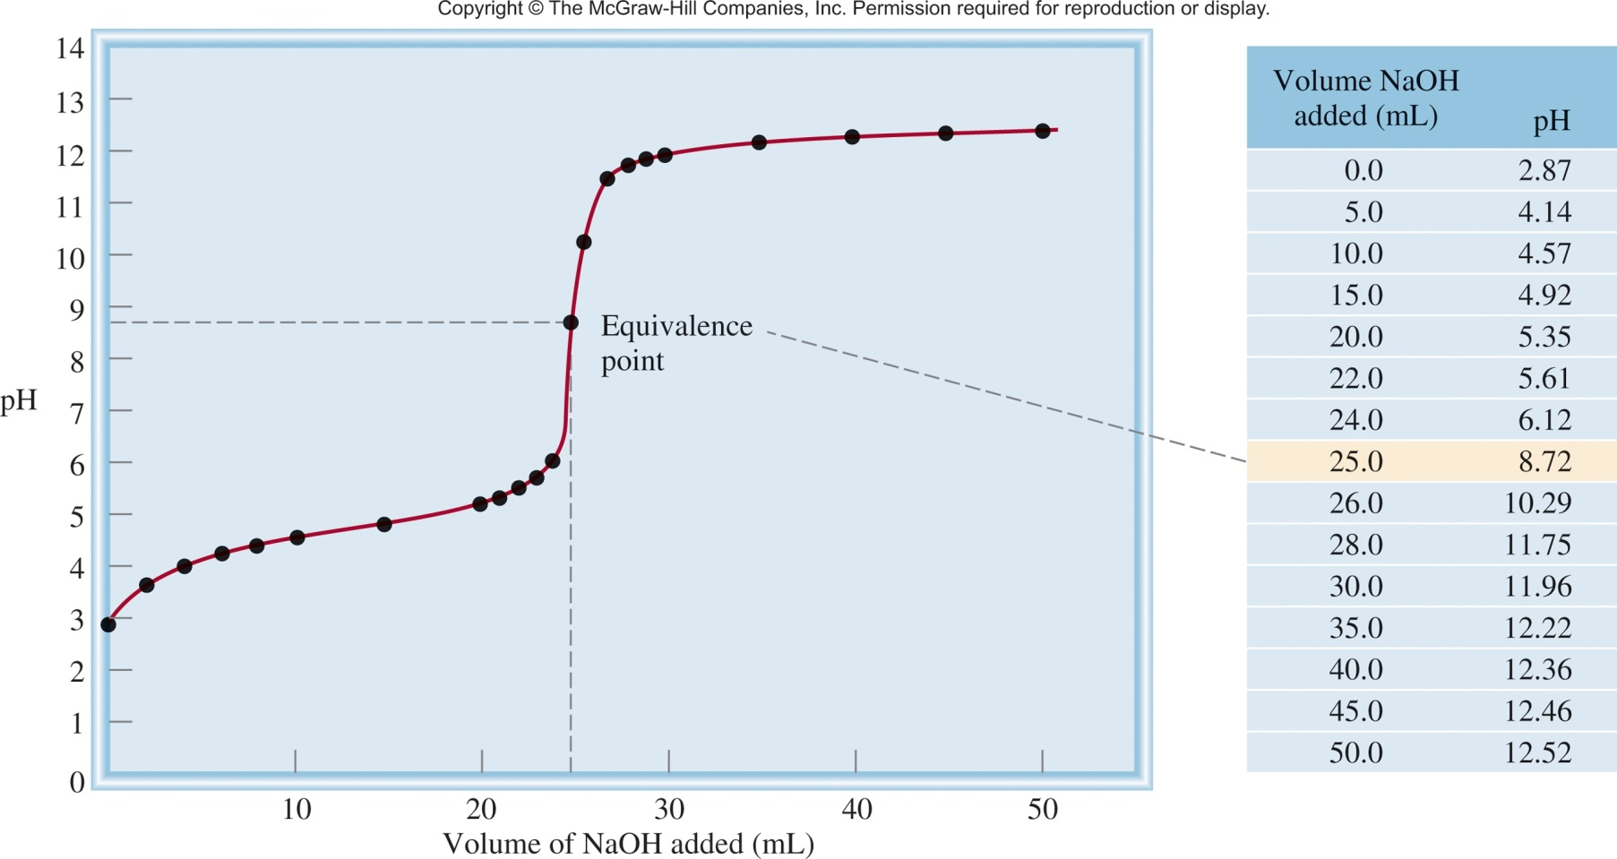
Strong base to weak acid
NaOH
CH₃COOH
CH₃COOH (aq) + NaOH (aq) CH₃COONa (aq) + H₂O (l)
CH₃COO⁻ (aq) + H₂O (l) CH₃COOH (aq) + OH⁻ (aq)
25.0 mL of 0.1 M CH₃COOH
adding 0.1 M NaOH

Slide 65
Strong base to weak acid
CH₃COOH (aq) + NaOH (aq) CH₃COONa (aq) + H₂O (l)
Start with:
25.0 mL of 0.1 M CH₃COOH
Adding:
0.1 M NaOH
Since there is an equilibrium calculating the pH is a little more difficult:
1) After the addition of 0 mL of 0.1 M NaOH.
CH₃COOH (aq) CH₃COO⁻ (aq) + H⁺ (aq)
[H⁺][A⁻]
K_{a} =
[HA]
ICE table + Math
[H⁺] = 1.3 x 10⁻³
K_{a} = 1.8 x 10⁻⁵
pH = -log (1.3 x 10⁻³) = 2.87

Slide 66
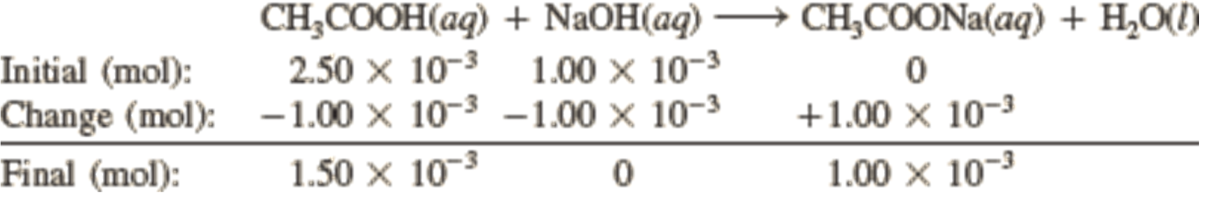
Strong base to weak acid
Start with: 25.0 mL of 0.1 M CH₃COOH
1) After the addition of 10 mL of 0.1 M NaOH.
moles of NaOH/OH⁻
moles of CH₃COOH
[A⁻]
pH = pK_{a} + log
[HA]
0.001
pH = -log (1.8 x 10⁻⁵) + log
0.0015
pH = 4.57

Slide 67



Strong base to weak acid
Start with: 25.0 mL of 0.1 M CH₃COOH
1) After the addition of 25 mL of 0.1 M NaOH.
moles of NaOH/OH⁻
moles of CH₃COOH
 | CH₃COOH (aq) | + NaOH (aq) |  | CH₃COONa(aq) | + H₂O(l)
Initial (mol): | 2.50 x 10⁻³ | 2.50 x 10⁻³ |  | 0
Change (mol): | -2.50 x 10⁻³ | -2.50 x 10⁻³ |  | +2.50 x 10⁻³
Final (mol): | 0 | 0 |  | 2.50 x 10⁻³
CH₃COO⁻ (aq) + H₂O (l) OH⁻ (aq) + CH₃COOH (aq)

Slide 68



Strong base to weak acid
Start with: 25.0 mL of 0.1 M CH₃COOH
1) After the addition of 35 mL of 0.1 M NaOH.
moles of NaOH/OH⁻
moles of CH₃COOH
 | CH₃COOH (aq) | + NaOH (aq) | → | CH₃COONa(aq) | + H₂O(l)
Initial (mol): | 2.50 x 10⁻³ | 3.50 x 10⁻³ |  | 0
Change (mol): | -2.50 x 10⁻³ | -2.50 x 10⁻³ |  | +2.50 x 10⁻³
Final (mol): | 0 | 1.00 x 10⁻³ |  | 2.50 x 10⁻³

Slide 69


Comparison
Strong base to a strong acid.
Strong base to a weak acid.
Inflection point
= pK_{a}
Inflection point
half way to the equivalence point.
Buffer Region
Strong base to a strong acid.
At high [NaOH], the pH curve is dominated by OH⁻.
Strong base to a weak acid.

Slide 70

Strong acid to weak base
HCl
NH₃
HCl (aq) + NH₃ (aq) NH₄Cl (aq)
NH₄⁺ (aq) NH₃ (aq) + H⁺ (aq)
25.0 mL of 0.1 M NH₃
adding 0.1 M HCl

Slide 71




Polyprotic Acids
Titration of H₂SO₃ with NaOH
There are two buffer regions and two equivalence points corresponding to each deprotonation step.
Each of these steps involves a conjugate acid – conjugate base equilibrium.
The pH at the intermediate equivalence point depends on the pK_{a} of the corresponding species.
pK_{a2} = 7.19
pH
pK_{a1} = 1.85

Slide 72


Monitoring pH
We want to know when we have reached the equivalence point.
pH Meter
pH Indicator
Strips = $0.05
>$1,500
Solution = $0.01

Slide 73



pH Indicator
Indicator – substance that changes color with respect to [H⁺]
HIn (aq) H⁺ (aq) + In⁻ (aq)
Color 1
Color 2
Add acid (H⁺) the equilibrium shifts left.
Remove H⁺ the equilibrium shifts right.
-H⁺
+H⁺
It changes from red (at pH 3.1) to orange-yellow (at pH 4.4):

Slide 74


pH Indicator
Slowly add base
to unknown acid
UNTIL
the indicator
changes to pink
phenolphthalein

Slide 75


Bromothymol Blue
pH 5
pH 8

Slide 76



Some indicators transition through several colors.
Usually composed of many color changing molecules.
pH

Slide 77
pH Indicator
Indicator – substance that changes color with respect to [H⁺]
HIn (aq) H⁺ (aq) + In⁻ (aq)
Color 1
Color 2
[HIn]
≥ 10
Color of acid (HIn) predominates
[In⁻]
[HIn]
≤ 10
Color of conjugate base (In⁻) predominates
[In⁻]
This corresponds to a change of ~2 pH units.
The key to a useful indicator for acid-base titrations is having the color change near the equivalence point.

Slide 78




Slide 79
Which indicator or indicators would you use for the acid-base titrations here:
Near the equivalence point, the pH of the solution changes abruptly from 4 to 10. Therefore, all the indicators except thymol blue, bromophenol blue, and methyl orange are suitable for use in the titration.

Slide 80

Which indicator or indicators would you use for the acid-base titrations here:
All the indicators except thymol blue, bromophenol blue, and methyl orange are suitable for use in the titration.

Slide 81
Which indicator or indicators would you use for the acid-base titrations here:
Here the steep portion covers the pH range between 7 and 10; therefore, the suitable indicators are cresol red and phenolphthalein.

Slide 82




Slide 83
CH 4, Review

